Slide 1
Lecture 7 – Generic Collections

Slide 2
Topics
Why Generics are required?
Generic types and functions ,
Type parameters and Constraints
Difference between templates in C++ and Generics in C#
Generic Delegates and event handling
Generic Interfaces

Slide 3
Introduction
Generics are the most powerful feature of C# 2.0. Generics allow you to define type-safe data structures, without committing to actual data types.
This results in a significant performance boost and higher quality code, because you get to reuse data processing algorithms without duplicating type-specific code.
In concept, generics are similar to C++ templates, but are drastically different in implementation and capabilities.

Slide 4
Why Generics are required?
Consider an everyday data structure such as a stack, providing the classic Push() and Pop() methods.
When developing a general-purpose stack, you would like to use it to store instances of various types.
Under C# 1.1, you have to use an Object-based stack, meaning that the internal data type used in the stack is an amorphous Object, and the stack methods interact with Objects.

Slide 5
An Object-based stack
public class Stack
{
int m_Size;
int m_StackPointer = 0;
object[] m_Items;
public Stack():this(100)
{}
public Stack(int size)
{
m_Size = size;
m_Items = new object[m_Size];
}

Slide 6
public void Push(object item)
{
if(m_StackPointer >= m_Size)
throw new StackOverflowException();
m_Items[m_StackPointer] = item;
m_StackPointer++;
}
public object Pop()
{
m_StackPointer--;
if(m_StackPointer >= 0)
return m_Items[m_StackPointer];
else
{
m_StackPointer = 0;
throw new InvalidOperationException("empty stack");
}
}
}

Slide 7
Problems with Object-based solutions
Performance – When using value types, you have to box them in order to push and store them, and unbox the value types when popping them off the stack. Boxing and unboxing incurs a significant performance penalty it also increases the pressure on the managed heap, resulting in more garbage collections

Slide 8
Type safety – the compiler lets you cast anything to and from Object, you lose compile-time type safety. Eg: the following code compiles fine, but raises an invalid cast exception at run time:
Stack stack = new Stack();
stack.Push(1);
string number = (string)stack.Pop();

Slide 9
Generics
Generics allow you to define type-safe classes without compromising type safety, performance, or productivity.
public class Stack<T>
{...}
Stack<int> stack = new Stack<int>();

Slide 10
Generic stack
public class Stack<T>
{
int m_Size;
int m_StackPointer = 0;
T[] m_Items;
public Stack():this(100){ }
public Stack(int size)
{
m_Size = size;
m_Items = new T[m_Size];
}

Slide 11
public void Push(T item)
{
if(m_StackPointer >= m_Size)
throw new StackOverflowException();
m_Items[m_StackPointer] = item;
m_StackPointer++;
}
public T Pop()
{
m_StackPointer--;
if(m_StackPointer >= 0)
return m_Items[m_StackPointer];
else
{
m_StackPointer = 0;
throw new InvalidOperationException("Cannot pop an empty stack");
}
}
}

Slide 12
default() operator
public T Pop()
{
m_StackPointer--;
if(m_StackPointer >= 0)
return m_Items[m_StackPointer];
else
{
m_StackPointer = 0;
return default(T);
}
}

Slide 13
Multiple Generic Types
class Node<K,T>
{
public K Key;
public T Item;
public Node<K,T> NextNode;
public Node()
{
Key = default(K);
Item = default(T);
NextNode = null;
}
public Node(K key,T item,Node<K,T> nextNode)
{
Key = key;
Item = item;
NextNode = nextNode;
}
}

Slide 14
public class LinkedList<K,T>
{
Node<K,T> m_Head;
public LinkedList()
{
m_Head = new Node<K,T>();
}
public void AddHead(K key,T item)
{
Node<K,T> newNode = new Node<K,T>(key,item,m_Head.NextNode);
m_Head.NextNode = newNode;
}
}
LinkedList<int,string> list = new LinkedList<int,string>();
list.AddHead(123,"AAA");

Slide 15
Generic type aliasing
using List = LinkedList<int,string>;
class ListClient
{
static void Main(string[] args)
{
List list = new List();
list.AddHead(123,"AAA");
}
}

Slide 16
Generic Constraints
The compiler compiles the generic code into IL independent of any type arguments that the clients will use. As a result, the generic code could try to use methods, properties, or members of the generic type parameters that are incompatible with the specific type arguments the client uses. This is unacceptable because it amounts to lack of type safety.

Slide 17
There are three types of constraints.
A derivation constraint indicates to the compiler that the generic type parameter derives from a base type such an interface or a particular base class.
A default constructor constraint indicates to the compiler that the generic type parameter exposes a default public constructor (a public constructor with no parameters).
A reference/value type constraint constrains the generic type parameter to be a reference or a value type.

Slide 18
Derivation Constraints
The “where” keyword on the generic type parameter followed by a derivation colon to indicate to the compiler that the generic type parameter implements a particular interface.

Slide 19
public class LinkedList<K,T> where K : IComparable
{
T Find(K key)
{
Node<K,T> current = m_Head;
while(current.NextNode != null)
{
if(current.Key.CompareTo(key) == 0)
break;
else
current = current.NextNode;
}
return current.Item;
}
. . .
}

Slide 20
Multiple interfaces on the same generic type parameter, separated by a comma. For example:
public class LinkedList<K,T>
where K : IComparable<K>,Iconvertible
{ . . . }
Constraints for every generic type parameter your class uses, for example:
public class LinkedList<K,T>
where K : IComparable<K>
where T : ICloneable

Slide 21
base class constraint
public class MyBaseClass
{...}
public class LinkedList<K,T> where K : MyBaseClass
{...}
constrain both a base class and one or more interfaces
public class LinkedList<K,T>
where K : MyBaseClass, IComparable<K>
{...}

Slide 22
Constructor Constraint
Suppose you want to instantiate a new generic object inside a generic class. The problem is the C# compiler does not know whether the type argument the client will use has a matching constructor, and it will refuse to compile the instantiation line.
Its overcome using the “new()” constraint.

Slide 23
class Node<K,T> where T : new()
{
public K Key;
public T Item;
public Node<K,T> NextNode;
public Node()
{
Key = default(K);
Item = new T();
NextNode = null;
}
}

Slide 24
Reference/Value Type Constraint
Value Type Constraint
public class MyClass<T> where T : struct
{...}
Reference Type Constraint
public class MyClass<T> where T : class
{...}

Slide 25
Generic Methods
A method can define generic type parameters, specific to its execution scope.
Generic Class:
public class MyClass<T>
{
public void MyMethod<X>(X x)
{...}
}
Non Generic Class:
public class MyClass
{
public void MyMethod<T>(T t)
{...}
}

Slide 26
Generic Delegates
A delegate defined in a class can take advantage of the generic type parameter of that class. For example:
public class MyClass<T>
{
public delegate void GenericDelegate(T t); public void SomeMethod(T t)
{...}
}
MyClass<int> obj = new MyClass<int>(); MyClass<int>.GenericDelegate del;
del = obj.SomeMethod;

Slide 27
Generic Event Handiling
namespace Generic_Delegates_and_Events
{
public delegate void GenericEventHandler<S,A>(S sender,A args); //generic delegate
public class MyPublisher
{
public event GenericEventHandler<MyPublisher,EventArgs> MyEvent;
public void FireEvent()
{
MyEvent(this,EventArgs.Empty);
}
}
public class MySubscriber<A> //Optional: can be a specific type
{
public void SomeMethod(MyPublisher sender,A args)
{
Console.WriteLine("MySubscriber::SomeMethod()");
}
}

Slide 28
public class MySubscriber2<A> //Optional: can be a specific type
{
public void SomeMethod2(MyPublisher sender, A args)
{
Console.WriteLine("MySubscriber2::SomeMethod2()");
}
}
class Program
{
static void Main(string[] args)
{
MyPublisher publisher = new MyPublisher();
MySubscriber<EventArgs> subscriber = new MySubscriber<EventArgs>();
publisher.MyEvent += subscriber.SomeMethod;
MySubscriber2<EventArgs> subscriber2 = new MySubscriber2<EventArgs>();
publisher.MyEvent += subscriber2.SomeMethod2;
publisher.FireEvent();
}
}
}

Slide 29
Differences Between C++ Templates and C# Generics
C# generics do not provide the same amount of flexibility as C++ templates.
C# does not allow non-type template parameters, such as template C<int i> {}.
C# does not support explicit specialization; that is, a custom implementation of a template for a specific type.
C# does not support partial specialization: a custom implementation for a subset of the type arguments.
C# does not allow the type parameter to be used as the base class for the generic type.
C# does not allow type parameters to have default types.
In C#, a generic type parameter cannot itself be a generic, although constructed types can be used as generics. C++ does allow template parameters.

Slide 30
C# Generics is more type safe than C++ templates.
C++ templates use a compile-time model. C# generics are not just a feature of the compiler, but also a feature of the runtime.
Code Bloating is reduced in C# compared to C++.
Generics have full run time support. Which is not available to templates.

Slide 31
Generic Interfaces
The System.Collections.Generic namespace contains interfaces and classes that define generic collections, which allow users to create strongly typed collections that provide better type safety and performance than non-generic strongly typed collections.

Slide 32
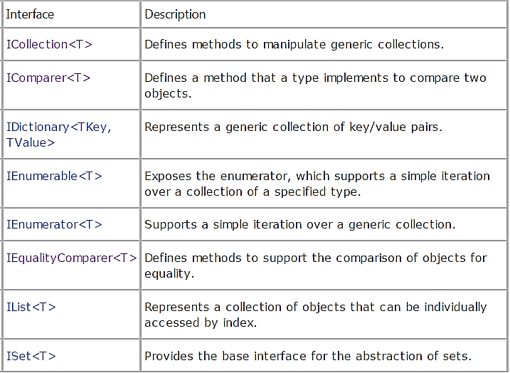

Slide 33
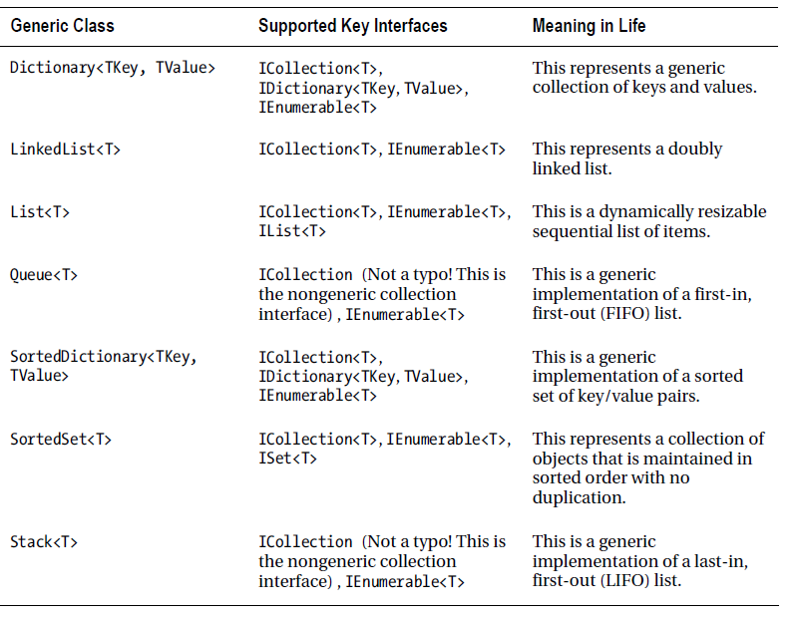
GENERIC COLLECTION CLASSES

Slide 34
ICollection<T>
Add(), Clear(), Contains(), CopyTo(), Remove(),Count, IsReadOnly
The interface ICollection<T> is implemented by collection classes. Methods of this interface can be used to add and remove elements from the collection. The generic interface ICollection<T> inherits from the non-generic interface IEnumerable. With this it is possible to pass objects implementing ICollection<T> to methods that require IEnumerable objects as parameters.
IList<T>
Insert(), RemoveAt(), IndexOf(),Item
The interface IList<T> allows you to access a collection using an indexer. It is also possible to insert or remove elements at any position of the collection. Similar to ICollection<T>, the interface IList<T> inherits from IEnumerable.
IEnumerable<T>
GetEnumerator()
The interface IEnumerable<T> is required if a foreach statement is used with the collection. This interface defines the method GetEnumerator() that returns an enumerator implementing IEnumerator<T>.The generic interface IEnumerable<T> inherits from the non-generic interface IEnumerable.

Slide 35
IEnumerator<T>
Current
The foreach statement uses an enumerator implementing IEnumerator<T> for accessing all elements in a collection. The interface IEnumerator<T> inherits from the non-generic interfaces IEnumerator and IDisposable. The interface IEnumerator defines the methods MoveNext() and Reset(), IEnumerator<T> defines the type-safe version of the property Current.
IDictionary<TKey, TValue>
Add(), ContainsKey(), Remove(), TryGetValue(),Item, Keys, Values
The interface IDictionary<K, V> is implemented by collections whose elements have a key and a value.
IComparer<T>
Compare()
The interface IComparer<T> is used to sort elements inside a collection with the Compare() method.
IEqualityComparer<T>
Equals(), GetHashCode()
IEqualityComparer<T> is the second interface to compare objects. With this interface the objects can be compared for equality. The method GetHashCode() should return a unique value for every object. The method Equals() returns true if the objects are equal, false otherwise.

Slide 36
The ICollection<T> interface is the base interface for classes in the System.Collections.Generic namespace.
The ICollection<T> interface extends IEnumerable<T>.
IDictionary<TKey, TValue> and IList<T> are more specialized interfaces that extend ICollection<T>.
A IDictionary<TKey, TValue> implementation is a collection of key/value pairs, like the Dictionary<TKey, TValue> class.
A IList<T> implementation is a collection of values, and its members can be accessed by index, like the List<T> class.

Slide 37
IEnumerable is an interface that defines one method GetEnumerator which returns an IEnumerator interface, this in turn allows readonly access to a collection. A collection that implements IEnumerable can be used with a foreach statement.

Slide 38
public interface ICustomInterface<T>
{
void ShowMethod();
void SomeMethod(T t);
}
class CustomClass<U> : ICustomInterface<U>
{
U u;
public CustomClass(U temp)
{
u = temp;
}
public void ShowMethod()
{
Console.WriteLine("Value: " + u);
}

Slide 39
public void SomeMethod(U t)
{
Console.WriteLine(t + " " + u);
}
}
class Program
{
static void Main(string[] args)
{
CustomClass<int> MyClass = new CustomClass<int>(10);
MyClass.ShowMethod();
CustomClass<int> MyClass2 = new CustomClass<int>(10);
MyClass2.SomeMethod(20);
}
}

Slide 40
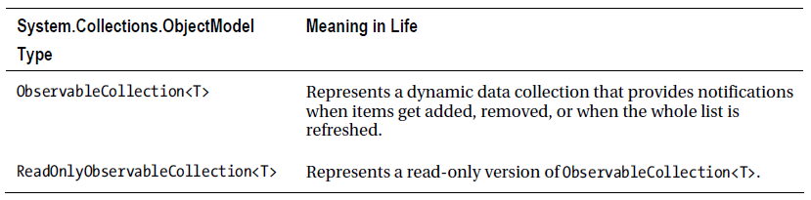
OBSERVABLE COLLECTIONS

Slide 41
EXAMPLE
static void Main(string[] args)
{
// Make a collection to observe and add a few Person objects.
ObservableCollection<Person> people = new ObservableCollection<Person>()
{
new Person{ FirstName = "Peter", LastName = "Murphy", Age = 52 },
new Person{ FirstName = "Kevin", LastName = "Key", Age = 48 },
};
// Wire up the CollectionChanged event.
people.CollectionChanged += people_CollectionChanged;
}
static void people_CollectionChanged(object sender,
System.Collections.Specialized.NotifyCollectionChangedEventArgs e)
{
throw new NotImplementedException();
}

Slide 42
PERFORMANCE OF DIFFERENT COLLECTION TYPES
Operation | Collection<T> | List<T> | LinkedList<T>
this[i] | O(1) | O(1) | -
Count | O(1) | O(1) | O(1)
Add(e) | O(1) or O(n) | O(1) or O(n) | O(1)
Insert(i,e) | O(n) | O(n) | -
Remove(e) | O(n) | O(n) | O(n)
IndexOf(e) | O(n) | O(n) | -
Contains(e) | O(n) | O(n) | O(n)
BinarySearch(e) | - | O(log n) | -
Sort() | - | O(n log n) or O(n²) | -
AddBefore(lln) | - | - | O(1)
AddAfter(lln,e) | - | - | O(1)
Remove(lln) | - | - | O(1)
RemoveFirst() | - | - | O(1)
RemoveLast() | - | - | O(1)

